Slide 1
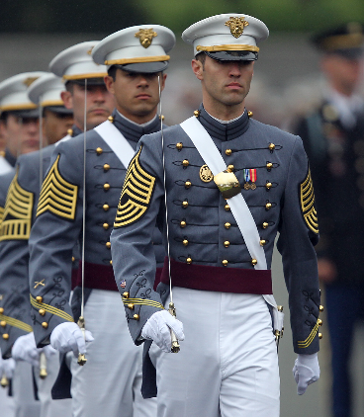
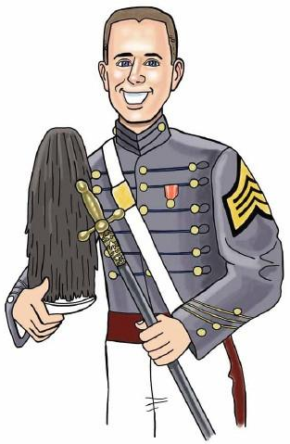
Modeling Performance in the Undergraduate Statistics Classroom
A
B
C
D
F
Educational Track
(8 Attributes)
Calculus
Modeling
Previous Performance
(5 Attributes)
Core Math
Educational Track
GPA
Overall Performance Score
Goal: Identify what factors influence a cadet’s statistical learning

Slide 2
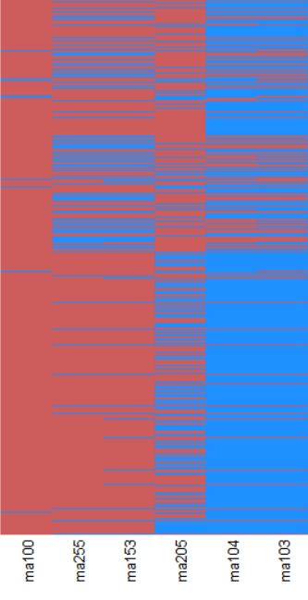


Data Wrangling
1019 Cadets over 2 Semesters
Identify Track
Advanced/Standard
STEM/Non STEM
Remedial
Collapse Factors
Single Variable Calculus
Multi Variable Calculus
Model Building
Impute Missing Data
<1%
K-NN (K=5)
Center/Scale

Slide 3
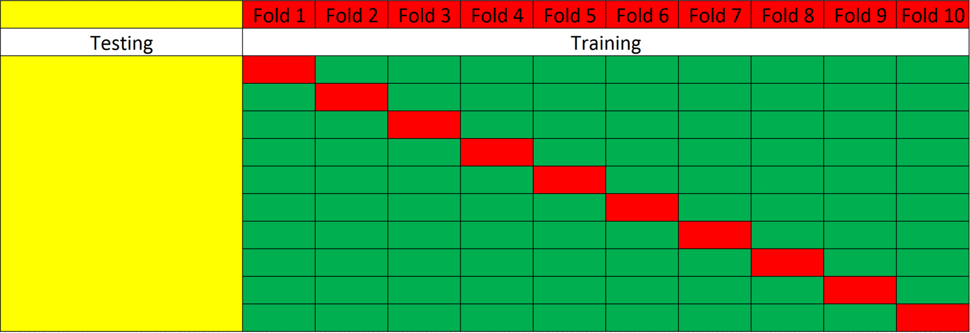

Model Control Structure
75% Training / 25% Testing
Structure
Tune parameters using repeated cross validation
Select parameters based on best cross validation score
CaRet: Classification and REgression Training in R

Slide 4
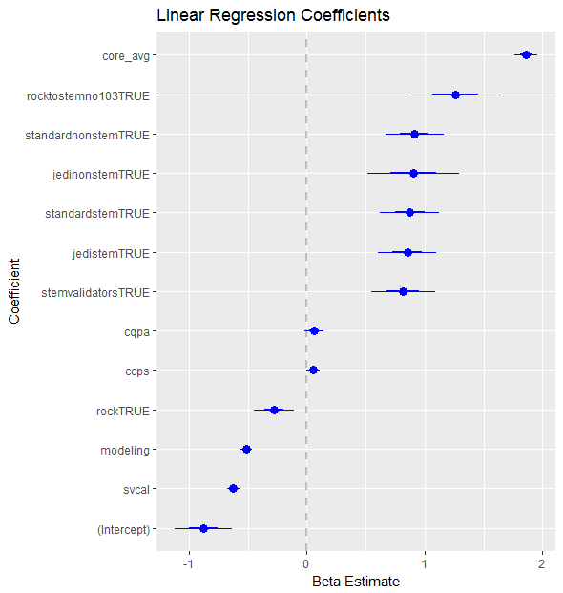
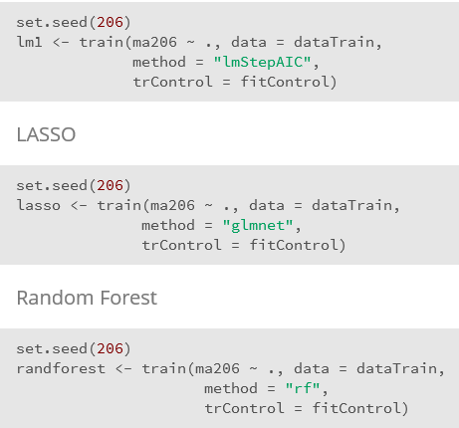
Model Execution
Linear Regression
LASSO
Random Forrest
Predict on holdout set for each model
CaRet: Classification and REgression Training in R

Slide 5
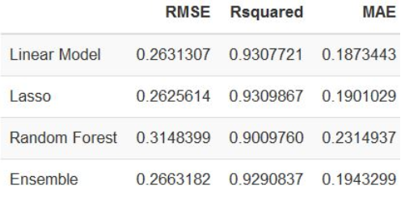
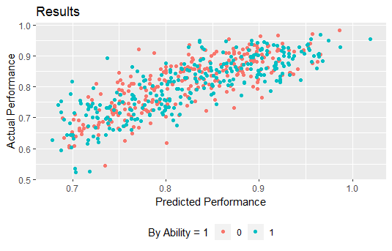
Model Ensemble and Performance
$Ensemble Model =$ $\frac{Linear Regression + LASSO + Random Forrest }{3}$
CaRet: Classification and REgression Training in R

Slide 6
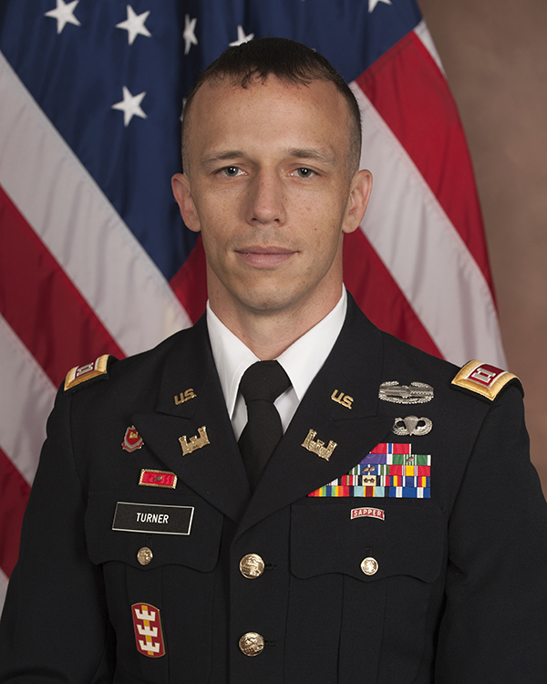
Contact Information
Work: dusty.s.turner.mil@mail.mil
Personal: dusty.s.turner@gmail.com
Blog: https://dusty-turner.netlify.com/
Github: https://github.com/dusty-turner
Twitter: @dtdusty

